Slide 1

2 chronicles 27:1 – 29:36
A CD of this message will be available (free of charge immediately following today's message)
This message will be available via podcast later this week at calvaryokc.com

Slide 2
2 chronicles 27:1 – 29:36
100 talents of silver
~ 7,500 lb. of silver
10,000 kors of wheat
~ 50,000 bushels of wheat
10,000 kors of barley
~ 50,000 bushels of barley

Slide 3
2 chronicles 27:1 – 29:36
David Y
1910-970BC
Solomon Y
970-930BC
Jehoram
847-840BC
Amaziah
796-768BC
Asa
911-871BC
Queen Athaliah
840-835BC
Jotham
739-735BC
1000 BC
950 BC
900 BC
850 BC
800 BC
750 BC
700 BC
650 BC
600 BC
550 BC
500 BC
Rehoboam
930-914BC
Jehoshaphat
871-847BC
Joash
835-796BC
Abijam
914-911BC
Azariah
840BC
Uzziah
768-739BC
Y | Ruled over united kingdom
Note: Some dates are approximate. Reigns do not include co-regencies
Kings of
Judah

Slide 4
2 chronicles 27:1 – 29:36
KJV ~ … for he made Judah naked, and transgressed sore against the LORD

Slide 5
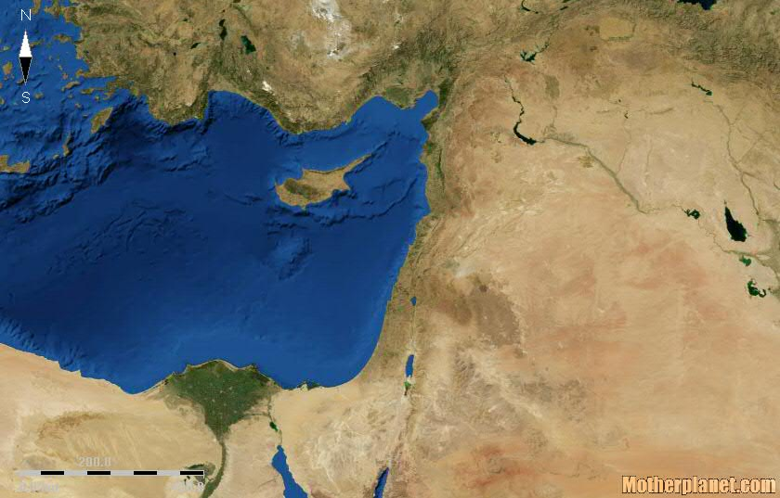
2 chronicles 27:1 – 29:36
Assyria
Syria
Philistia
Israel
Judah
Edom

Slide 6
2 chronicles 27:1 – 29:36
David Y
1910-970BC
Solomon Y
970-930BC
Jehoram
847-840BC
Amaziah
796-768BC
Asa
911-871BC
Queen Athaliah
840-835BC
Jotham
739-735BC
1000 BC
950 BC
900 BC
850 BC
800 BC
750 BC
700 BC
650 BC
600 BC
550 BC
500 BC
Rehoboam
930-914BC
Jehoshaphat
871-847BC
Joash
835-796BC
Ahaz
735-715BC
Abijam
914-911BC
Azariah
840BC
Uzziah
768-739BC
Y | Ruled over united kingdom
Note: Some dates are approximate. Reigns do not include co-regencies
Kings of
Judah

Slide 7
2 chronicles 27:1 – 29:36
Rom. 5:1 ~ Therefore, having been justified by faith, we have peace with God through our Lord Jesus Christ,
Col. 3:15 ~ And let the peace of God rule in your hearts, to which also you were called in one body; and be thankful.

